Slide 1
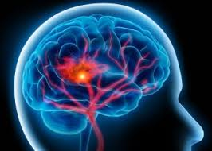
STROKE PREDICTION
RNS INSTITUTE OF TECHNOLOGY
BENGALURU - 98
DEPARTMENT OF COMPUTER SCIENCE & ENGINEERING
Presentation on Internship
PRESENTED BY:
NANDITA R P
1RN19CS086
MAMATHA LOGANATH
1RN19CS073

Slide 2
AGENDA
Abstract
About the Company
Introduction
Literature Survey
Requirements
System Design
Implementation
Results
Conclusion and Future Enhancements
References
Q & A

Slide 3
ABSTRACT
Stroke is a medical condition in which the blood vessels in the brain rupture, causing brain damage. Symptoms may appear if the brain's flow of blood and other nutrients is disrupted.
Stroke prediction has been discovered to be a complex operation that necessitates a large amount of data pre-processing. There is also a need to automate the prediction process for the early detection of stroke symptoms so that it can be avoided.
A variety of machine learning (ML) models have been created to predict the chance of a brain stroke. This study trains four alternative models for accurate prediction using a variety of physiological indicators and machine learning methods such as Logistic Regression (LR), Decision Tree (DT) Classification, Random Forest (RF) Classification, and SVM Classifier. As a result, a preliminary comparison is made between the various algorithms, and the most competent one is chosen.

Slide 4
ABOUT THE COMPANY
NASTECH – New Age Solutions & Technologies
NASTECH is formed with the purpose of bridging the gap between Academia and Industry.
Nastech is one of the leading Global Certification and Training service providers for technical and management programs for educational institutions.
They collaborate with educational institutes to understand their requirements and form a strategy in consultation with all stakeholders to fulfill those by skilling , reskilling and upskilling the students and faculties on new age skills and technologies.
Industry and project-oriented student training programs.
Certification programs mapped to Global Certification Exams from Microsoft/EC- Council/Google/AWS/ Adobe).

Slide 5
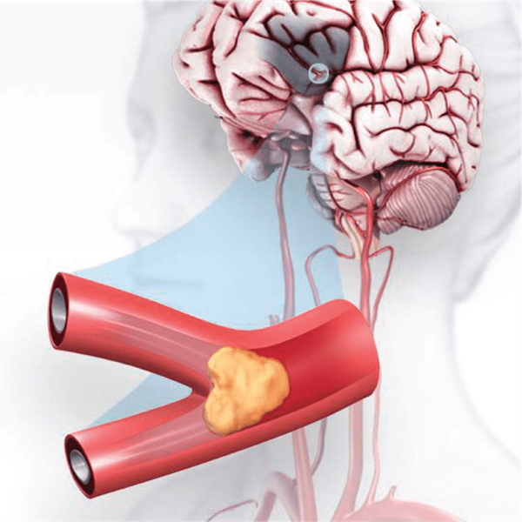
INTRODUCTION
A clot blocking blood flow to the brain (called an ischemic stroke) or a blood vessel rupturing and restricting blood flow to the brain (called a hemorrhagic stroke) can both cause stroke (called a hemorrhagic stroke). A brief clot causes a TIA (transient ischemic attack), sometimes known as a "mini stroke."
The brain is a very sophisticated organ that regulates many bodily activities. If a stroke happens and blood flow cannot reach the region that regulates a certain biological function, that part of the body will not operate properly.
Stroke prediction is critical, and strokes must be treated as soon as possible to prevent permanent damage or death. With advancements in medical technology, it is now feasible to predict the start of a stroke using ML approaches. The algorithms in ML are useful because they provide precise prediction and correct analysis.

Slide 6
LITERATURE SURVEY
In [1] various classification algorithms are studied and the most accurate model is obtained for predicting the stroke in the patient.It was found that Decision Tree and SVM were the most efficient algorithms while KNN was found to be the most ineffective one.
In [2] different oversampling techniques are mentioned for imbalance diets.This survey work also finds out some of the major flaws associated with stroke related topics ,so that a suitable solutions can be proposed in order to overcome the disease.

Slide 7
REQUIREMENTS
HARDWARE REQUIREMENTS
Processor : Any Processor above 500 MHz
RAM : 512Mb
Hard Disk : 4 GB
Input device : Standard Keyboard and Mouse
Output device : VGA and High Resolution Monitor
SOFTWARE REQUIREMENTS
Operating system : Windows 10
IDE : Jupyter Notebook, PyCharm
Tools/Technologies : Python, Flask, Matplotlib, HTML, pandas

Slide 8
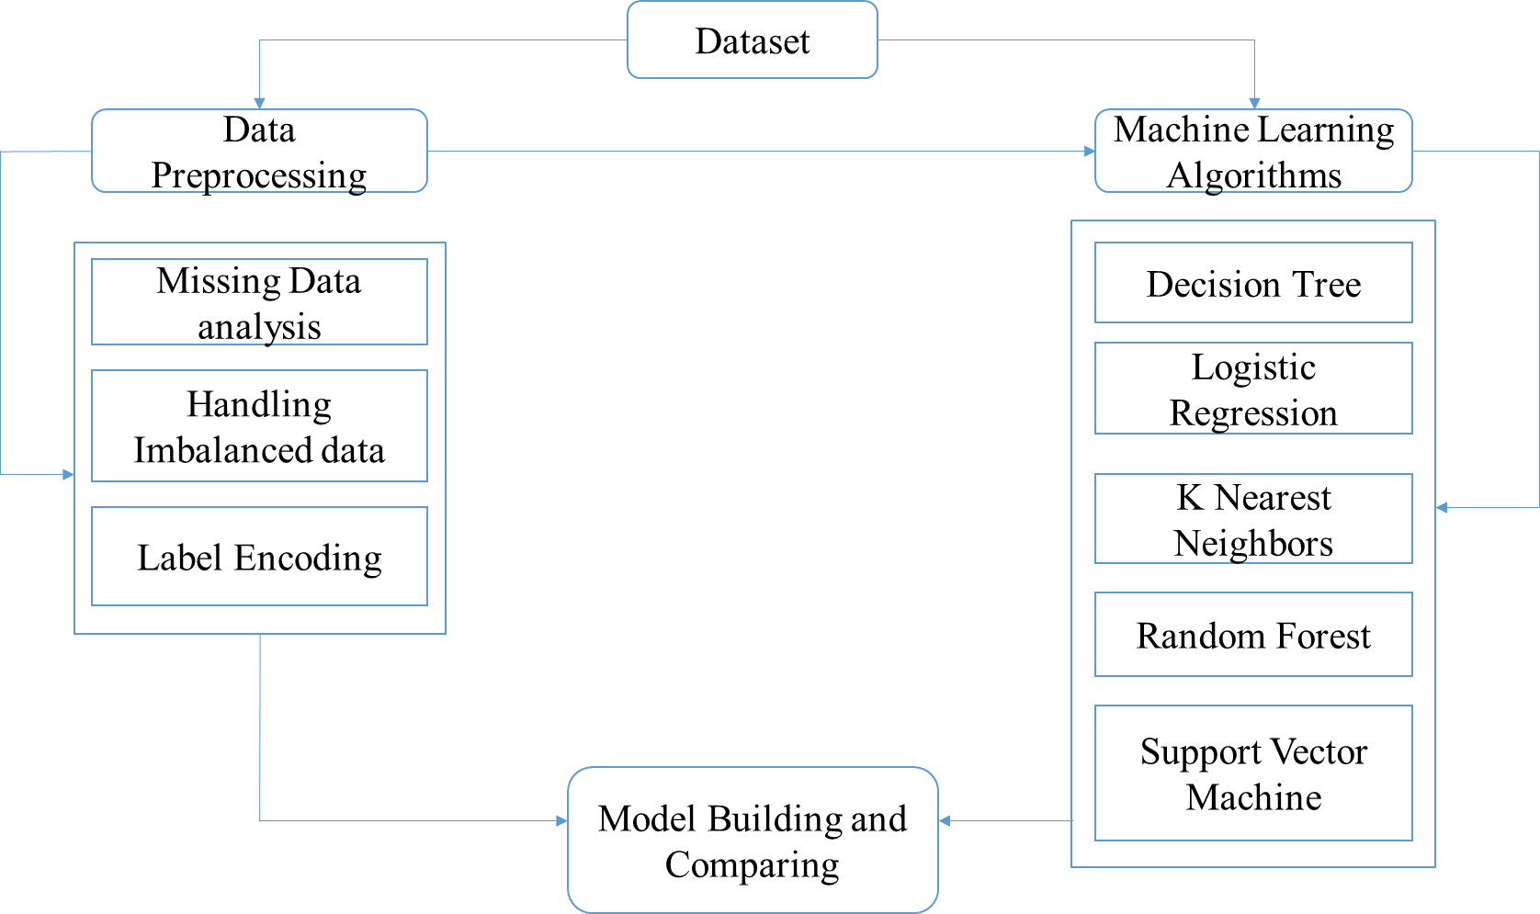
SYSTEM DESIGN
The project is divided into two phases, as shown in the diagram.
The first phase involves loading, pre-processing, and training the data set. During this phase, the model that performs the best training on the data set, i.e. the model with the highest accuracy, is stored to disc.
Phase 2 involves loading the model that was saved in the previous phase in order to create the project's front end.

Slide 9
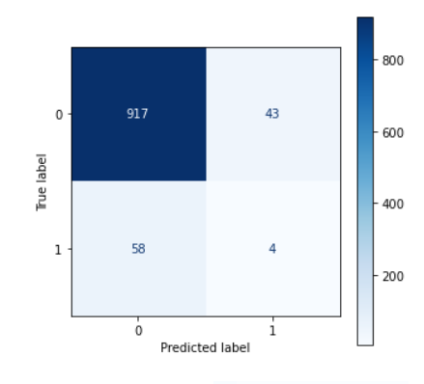
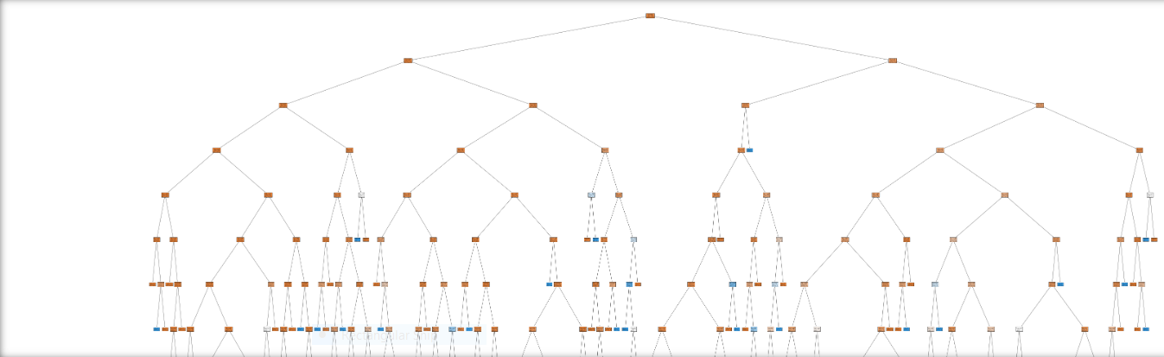
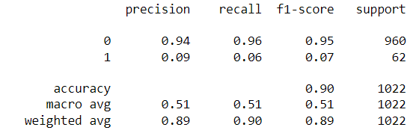
IMPLEMENTATION
DECISION TREE
Decision tree is a tree-structured classifier, where internal nodes represent the features of a dataset, branches represent the decision rules and each leaf node represents the outcome.
It is a graphical representation for getting all the possible solutions to a problem/decision based on given conditions.
ACCURACY – 90.80%

Slide 10
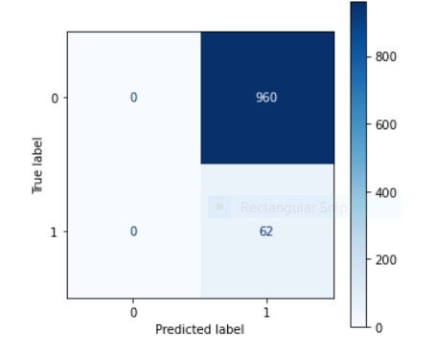
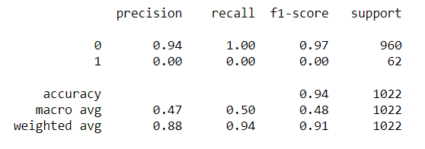
LOGISTIC REGRESSION
The method of modelling the probability of a discrete result given an input variable is known as logistic regression.
The most popular logistic regression models include a binary result, which can have two values such as true/false, yes/no, and so on.
Logistic regression is a helpful analytical tool for classification issues, such as determining if a new sample belongs in a specific group.
ACCURACY – 94 %

Slide 11
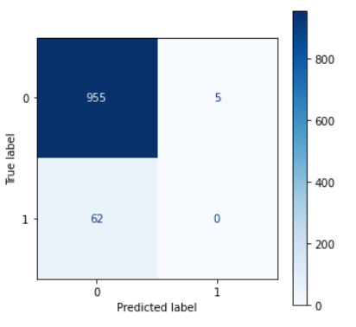
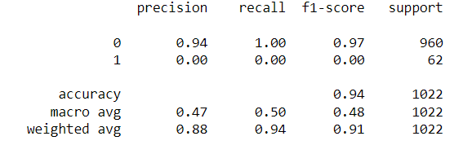
K - Nearest Neighbour
K-NN algorithm stores all the available data and classifies a new data point based on the similarity. This means when new data appears then it can be easily classified into a well suite category by using K- NN algorithm.
A commonly used distance metric for continuous variables is Euclidean Distance. For discrete variables, such as for text classification, another metric can be used, such as the overlap metric (or Hamming Distance).
ACCURACY – 94.52 %

Slide 12
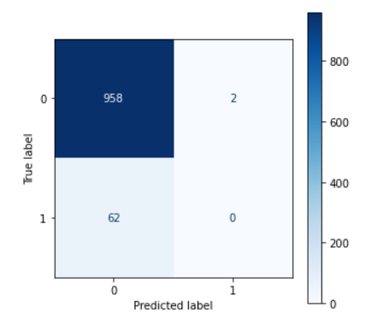
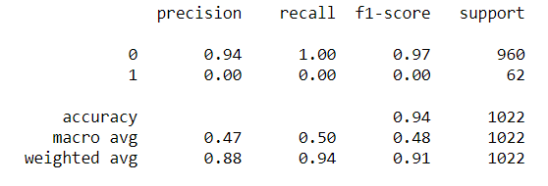
RANDOM FOREST
Random Forest is a classifier that contains a number of decision trees on various subsets of the given dataset and takes the average to improve the predictive accuracy of that dataset.
Instead of relying on one decision tree, the random forest takes the prediction from each tree and based on the majority votes of predictions, and it predicts the final output.
ACCURACY – 94.68 %

Slide 13
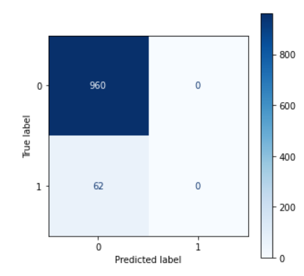
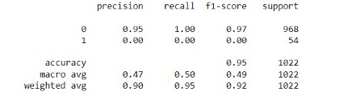
SUPPORT VECTOR MACHINE
The model memorizes from the past data and forms future predictions as output.
It pursues on the labelled sample data to find the decision boundary which produces the new unlabelled data and after that the new data is plotted from which the new value is anticipated
ACCURACY – 95 %

Slide 14
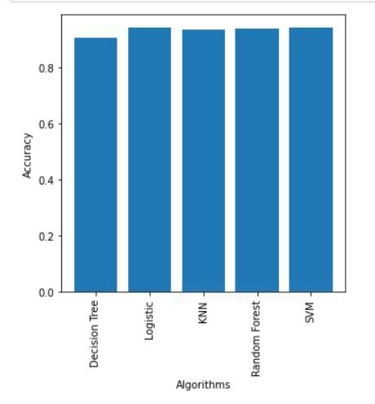
PERFORMANCE COMPARSION

Slide 15
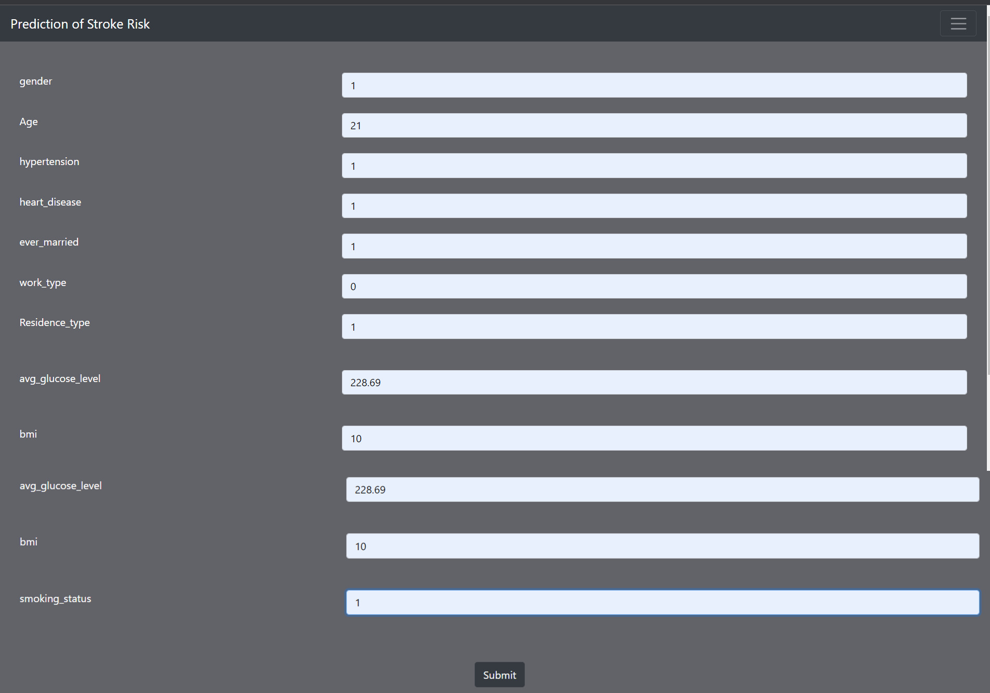
RESULTS

Slide 16
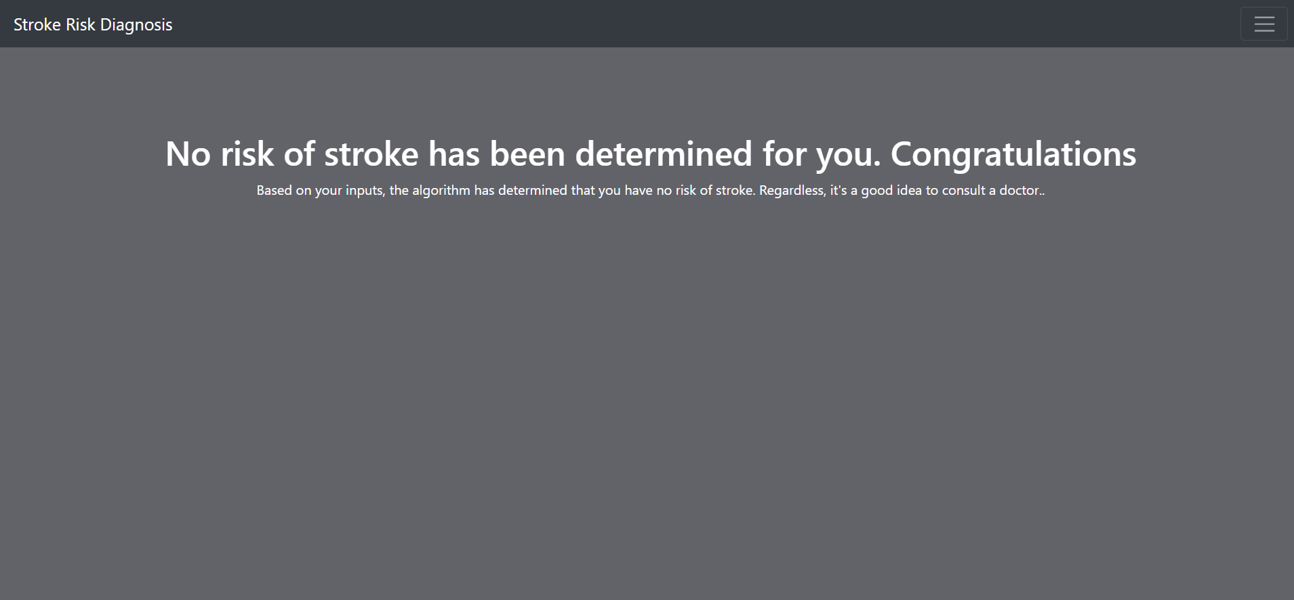
RESULTS

Slide 17
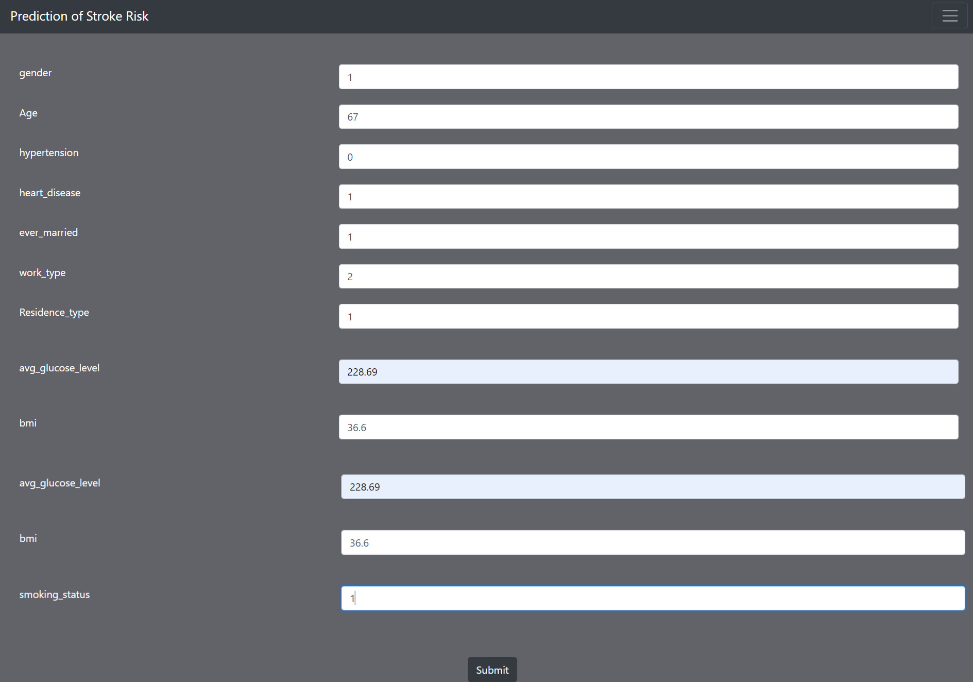

Slide 18
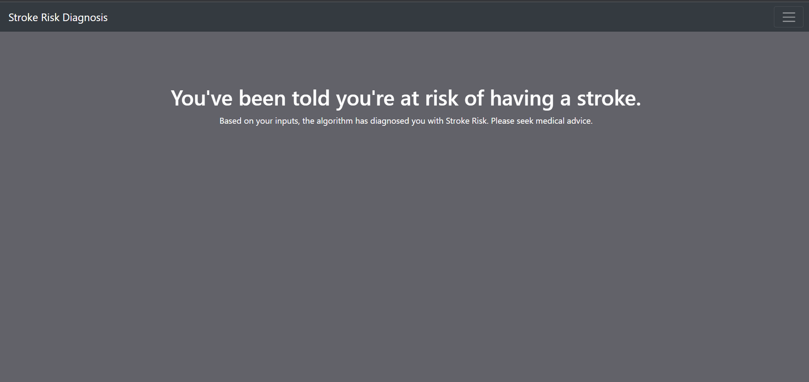

Slide 19
CONCLUSIONS AND FUTURE ENHANCEMENTS
Stroke is a potentially fatal medical condition that must be treated as soon as possible to prevent future consequences. The construction of a machine learning model may assist in the early identification of stroke and the subsequent reduction of its severe repercussions. In this work, the usefulness of multiple machine learning algorithms in correctly predicting stroke based on a variety of physiological factors is studied.
The machine learning architecture may assist the general public in identifying the possibility of a stroke developing in an adult patient in return for only supplying some basic information. In an ideal world, it would assist patients in receiving early stroke treatment and rebuilding their lives following the incident.
A study of several machine learning algorithms is utilised in this project. In the future, we will extend the project by using a deep learning algorithm.

Slide 20
REFERENCES
[1] T.Rakshit and A.Shrestha ,”Comparative analysis and implementation of stroke prediction using various machine learning techniques
[2] . H .Shashank ,S . Srikanth ,A .Thejas ,et.al ,Prediction Of Stroke Using Machine Learning ,PhD thesis,CMR Institute of technology ,Bangalore ,2020.
[3] .“Statistics of stroke by Centers for disease control and prevention,” [Online]. Available: https://www.cdc.gov/stroke/facts.htm.
[4]. “Documentation for decision tree classification from scikit-learn,” org. [Online]. Available: https://scikit-learn.org/stable/modules/tree.html.

Slide 21
THANK YOU

